Slide 1
Resting Alpha state activity related to SNR 50
Methods
Participants (n=32): Mean age=65 (31-78). Mild to moderate hearing loss. Hearing aid users
Measures:
Alpha power (7.5-12.5 hz) in occipital brain regions
Signal to noise ratio (SNR) threshold at 50% correct (SNR-50)
Subjective measures of hearing loss
EEG
64-channel EEG monitored using Neuroscan
Reference – Cz. Ground – Afz
Eyes alternate between open and closed conditions lasting 2 minutes each. 3 trials. 12 minutes total
EEG data analyzed in Matlab using Fieldtrip
Data bandpass filtered between .5 and 50 hz
Independent component analysis removed components related to signal, eye movement, and cardiac noise
FFT analysis run using Hanning window
Alpha power calculated between 7.5 and 12.5 hz
Alpha peak selected between 7.5 and 12.5 hz. Peak +/- 2hz are selected as a 4 hz window.
Alpha peak power is calculated around 4 hz window

Slide 2
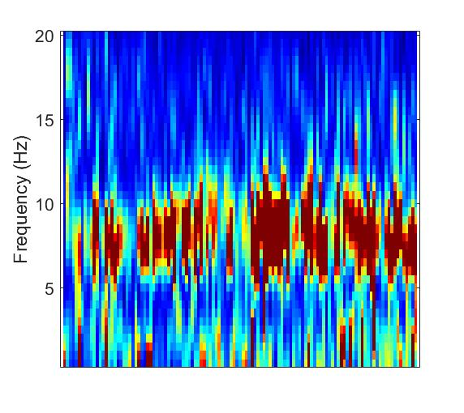
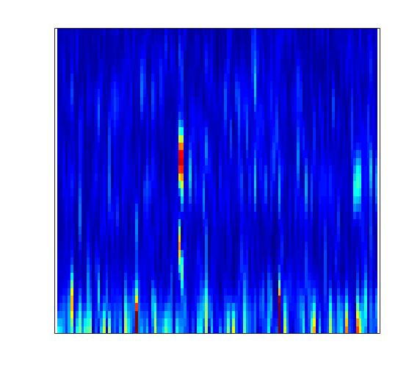
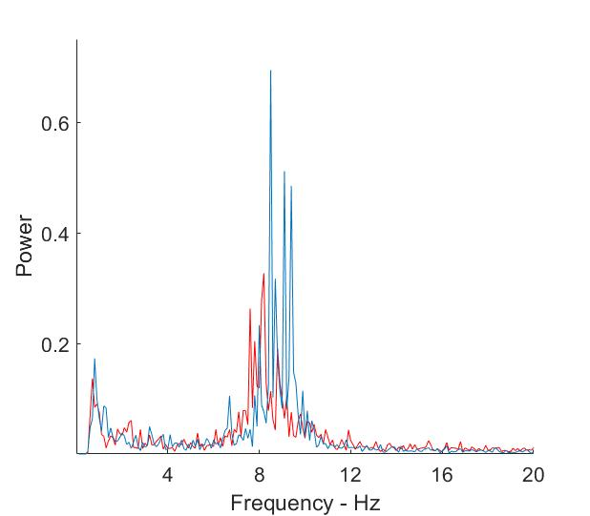
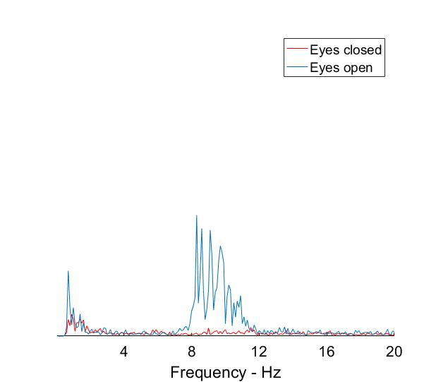

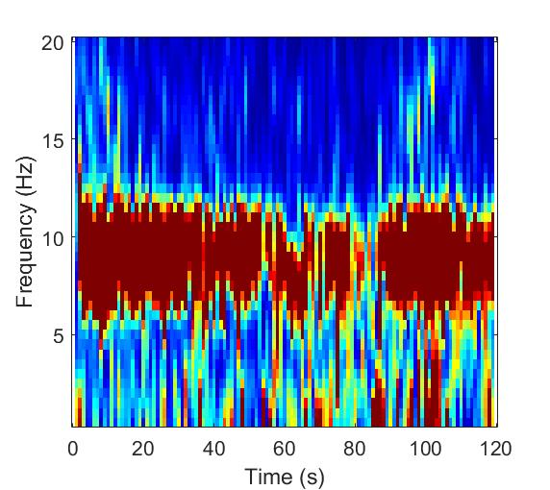
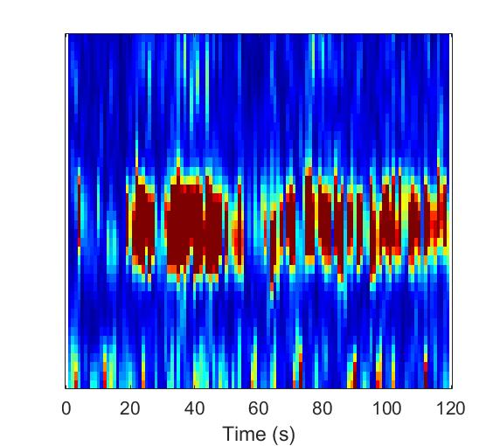
Sample Spectral data from single subject
Power
Frequency (Hz)
Frequency (Hz)
Time (seconds)

Slide 3
SNR study
MoCA – Montreal Cognitive Assessment
Test Box Measures
ANSI
DIR (SNR = 3)
DNR (AC 70 dB)
ANL (Unaided) – Acceptable Noise Level
HINT/PPT (Unaided)- Hearing In Noise Test
Real Ear Measures
MLST & Listening Effort Estimates – Multimodal Lexical Sentence Test
APHAB – Abbreviated Profile of Hearing Aid Benefit
HHIE/HHIA – Hearing Handicap Inventory for Elderly
DOSO – Development of the Device-Oriented Subjective Outcome SADL – Satisfaction with Amplification in Daily Life IOI-HA – International Outcome Inventory for Hearing Aids
SSQ12 – Speech Spatial and Qualities of Hearing
ALDQ
LESQ
NEO-FFI
Reading Span
Word Span

Slide 4
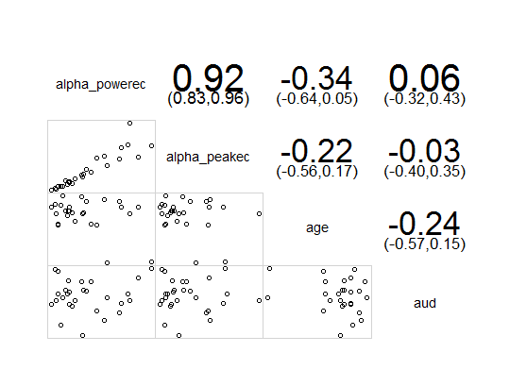
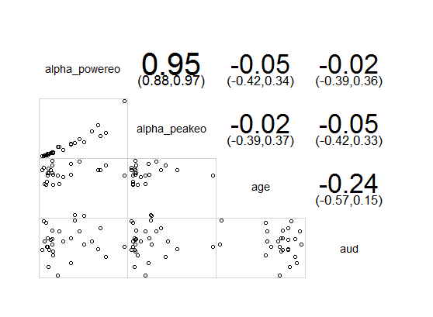
Alphapower vs age and audibility
Eyes Closed
Eyes Open

Slide 5
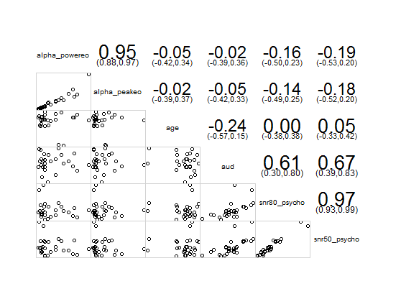

Alpha power vs SNR 50 and SNR 80

Slide 6
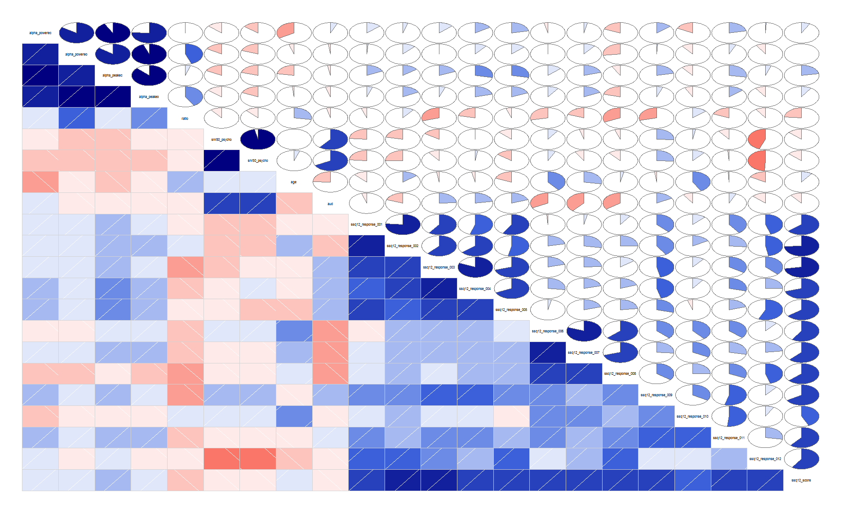
SSQ 12: Individual Responses

Slide 7
lm(formula = alpha_power_peakeo ~ ssq12_response_001 + ssq12_response_002 +
ssq12_response_003 + ssq12_response_004 + ssq12_response_005 +
ssq12_response_006 + ssq12_response_007 + ssq12_response_008 +
ssq12_response_009 + ssq12_response_010 + ssq12_response_011 +
ssq12_response_012 + ssq12_score, data = all_data)
Residuals:
Min 1Q Median 3Q Max
-4.267 -1.579 0.481 1.103 4.114
Coefficients: (1 not defined because of singularities)
Estimate Std. Error t value Pr(>|t|)
(Intercept) 4.01176 3.12918 1.282 0.22222
ssq12_response_001 -0.06884 0.05636 -1.221 0.24367
ssq12_response_002 0.05261 0.04865 1.082 0.29909
ssq12_response_003 -0.12122 0.05493 -2.207 0.04591 *
ssq12_response_004 0.09130 0.06493 1.406 0.18310
ssq12_response_005 0.03365 0.05633 0.597 0.56055
ssq12_response_006 0.02033 0.05568 0.365 0.72084
ssq12_response_007 0.09809 0.05311 1.847 0.08763 .
ssq12_response_008 -0.16605 0.04444 -3.736 0.00249 **
ssq12_response_009 0.01210 0.03178 0.381 0.70954
ssq12_response_010 -0.06275 0.03215 -1.952 0.07288 .
ssq12_response_011 0.10243 0.05134 1.995 0.06741 .
ssq12_response_012 0.04819 0.04335 1.112 0.28639
ssq12_score NA NA NA NA
---
Signif. codes: 0 ‘***’ 0.001 ‘**’ 0.01 ‘*’ 0.05 ‘.’ 0.1 ‘ ’ 1
Residual standard error: 3.094 on 13 degrees of freedom
(2 observations deleted due to missingness)
Multiple R-squared: 0.6359, Adjusted R-squared: 0.2998
F-statistic: 1.892 on 12 and 13 DF, p-value: 0.1341

Slide 8
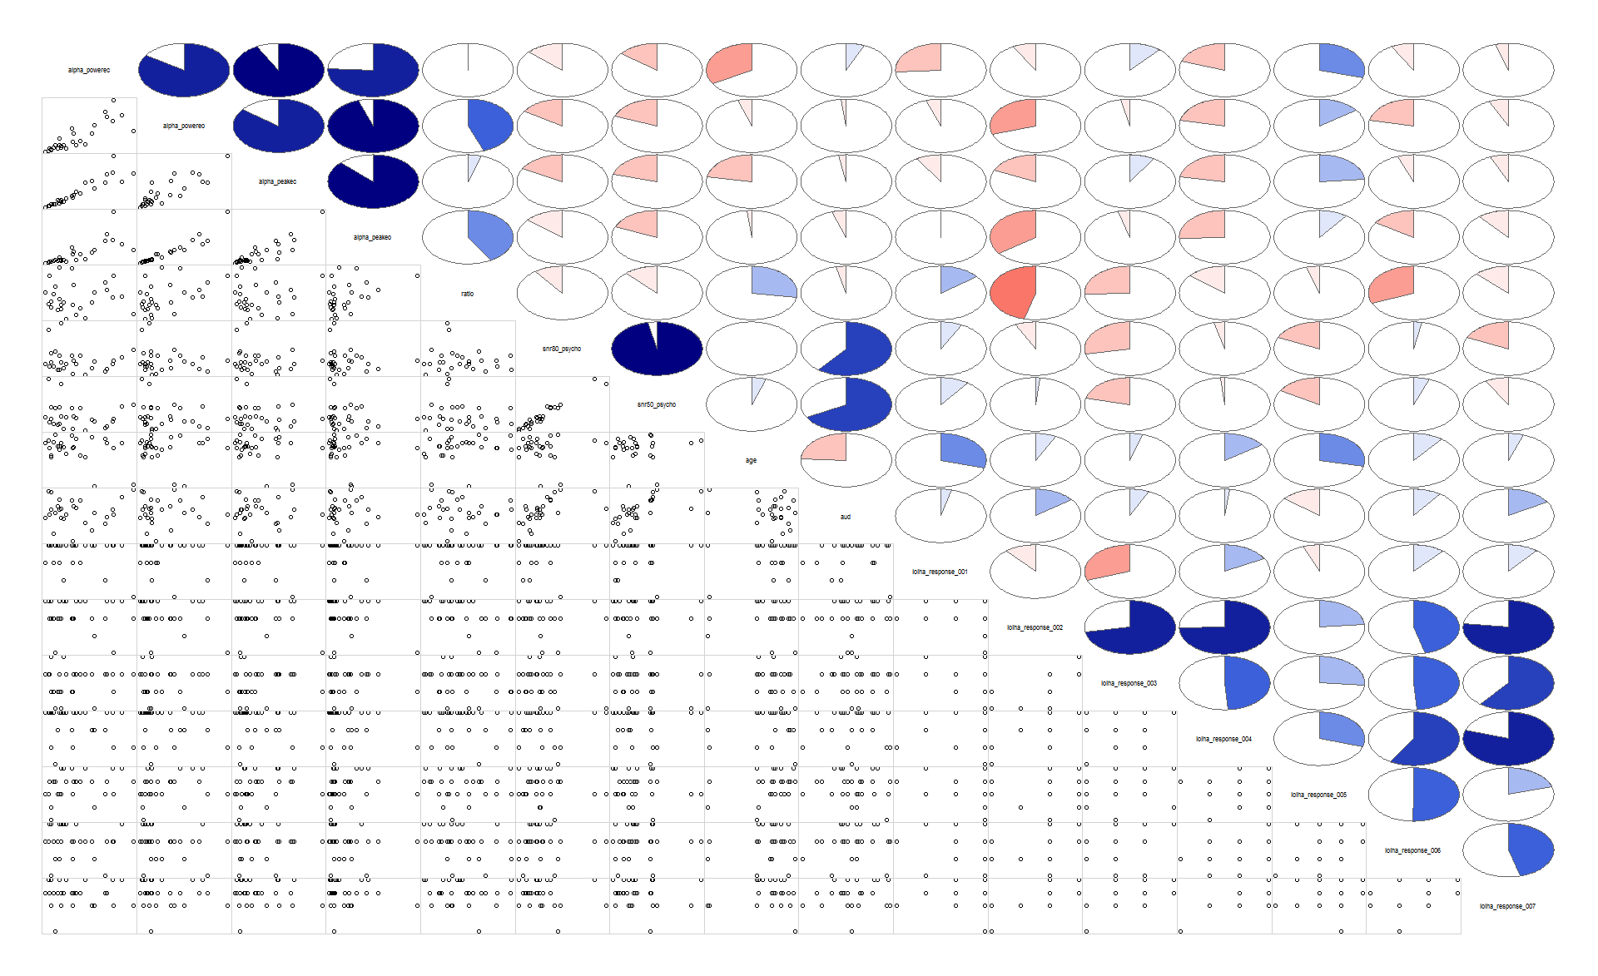
IOI: Individual Responses

Slide 9
lm(formula = alpha_power_peak_ratio ~ ioiha_response_001 + ioiha_response_002 + ioiha_response_003 + ioiha_response_004 + ioiha_response_005 + ioiha_response_006 + ioiha_response_007, data = all_data)
Residuals: Min 1Q Median 3Q Max
-0.36982 -0.10673 -0.05996 0.11369 0.44908
Coefficients:
Estimate Std. Error t value Pr(>|t|)
(Intercept) 1.03769 0.39138 2.651 0.01532 *
ioiha_response_001 0.00596 0.06214 0.096 0.92454
ioiha_response_002 -0.28609 0.09801 -2.919 0.00849 **
ioiha_response_003 0.07585 0.08924 0.850 0.40545
ioiha_response_004 0.12792 0.09585 1.334 0.19704
ioiha_response_005 0.02994 0.04673 0.641 0.52901
ioiha_response_006 -0.12816 0.07006 -1.829 0.08230 .
ioiha_response_007 0.07116 0.08530 0.834 0.41396
---
Signif. codes: 0 ‘***’ 0.001 ‘**’ 0.01 ‘*’ 0.05 ‘.’ 0.1 ‘ ’ 1
Residual standard error: 0.2128 on 20 degrees of freedom
Multiple R-squared: 0.4068, Adjusted R-squared: 0.1992
F-statistic: 1.96 on 7 and 20 DF, p-value: 0.1126

Slide 10
Questions:
Measure alpha in ERP data?
ISI-2-2.5 seconds
300-400 msec alpha suppression
alpha suppression after syllable
2012 parametric variation Strauss, Neuroimage
Pz, change in alpha compared to baseline. 400-800 msec
Add noise, reduce alpha suppression.
Fieldtrip tutorial. Trials time frequency, intertrial phase coherence
Han taper window FT-frac analysis
Time frequency code

